Slide 1



Your IT Transformation Partner
Version : 1.5 Last Updated on : 1st January 2018
MWX – Online Taxi Booking System – Screen Flow v1.1
1

Slide 2
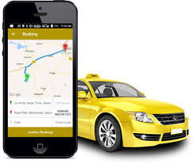
Online Taxi Booking System – Feature List
Registration management
Schedule your ride
Rate Cards Management
Passenger Management
Payment Management
Profile Setup
Transaction Management
Tracking
Admin setup

Slide 3
APP MODULES
2

Slide 4
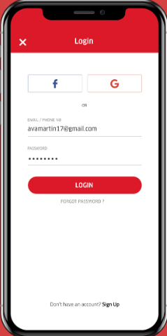
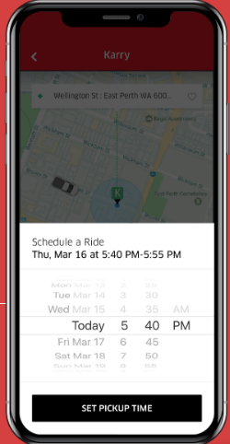
Register and Login
Register with profile details & login via email ID, phone number or social media account.
Schedule Your Ride
Pick a date for your ride.
4

Slide 5
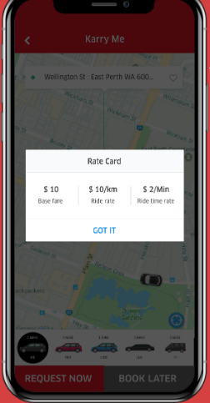
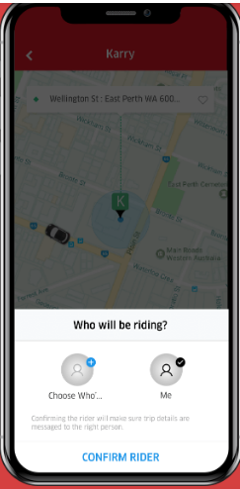
Rate Cards
View the rate card for each individual vehicle type before booking.
Choose Passenger
Book a ride for yourself or a friend.
5

Slide 6
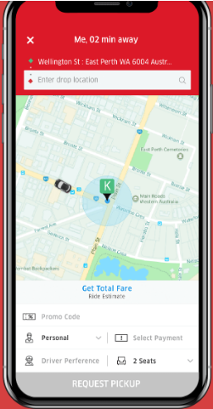
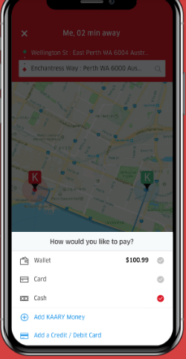
View and Update Ride Details
Enter drop location & various other ride details on the Taxi booking App.
Payment Preferences
Choose your preferred mode of payment on your on-demand taxi script through cash, card & wallet options.

Slide 7
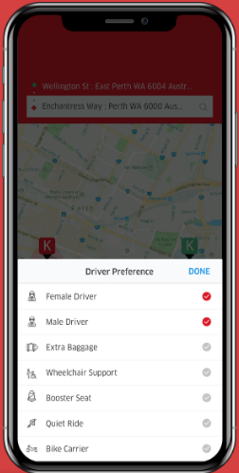
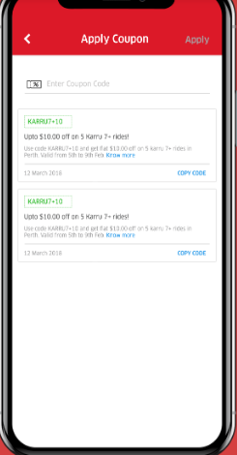
New Driver Preferences
We’ve updated our driver preferences giving the users more flexibility during ride bookings. Options provided can cater to the individual or for additional passengers.
Promo Codes
Check for promo codes & offers running. Just select the code to avail a discount from the total fare. Promo codes & loyalty programs are managed on the taxi booking app/admin.

Slide 8
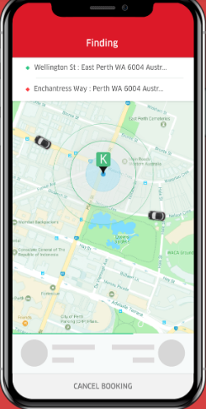
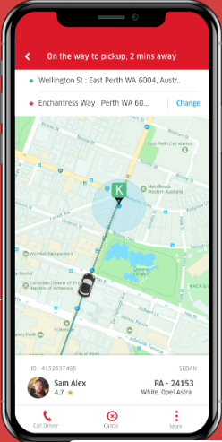
Acceptance
Once the customer preferences have been entered, the taxi booking app then searches for the nearest available driver that matches the user’s preferences.
Live Tracking
Real-time map view of your booked taxi service integrated into our taxi booking software. Users can additionally view their load details call their drivers for additional route or load details.

Slide 9
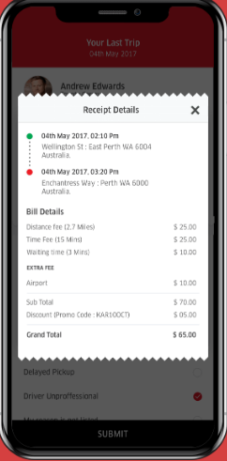
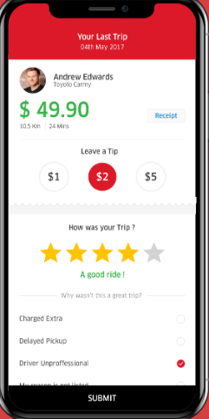
Receipt
View a detailed invoice of the booked taxi service.
Ratings
Rate your cab driver on a number of factors. This ensures high courier delivery quality standards are maintained by the admin & the business.

Slide 10
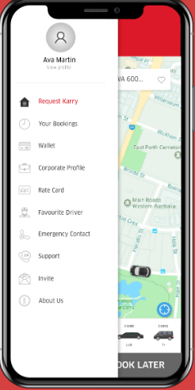
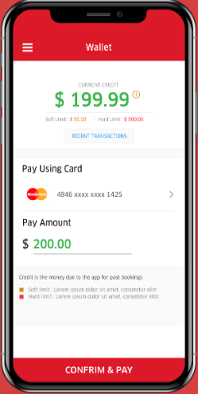
Additional Features
Profile Side Bar
Various profile options to further enhance user experience.
Wallet
In-app wallet module integrated in the taxi Booking App , for quick payments during bookings. Soft & Hard limits are setup by the admin to prevent the customer from making cash bookings, if a certain credit amount is due to the app.

Slide 11
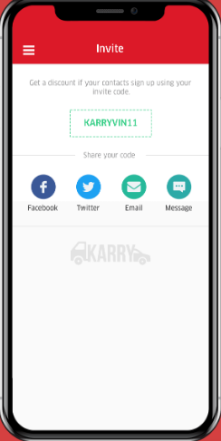
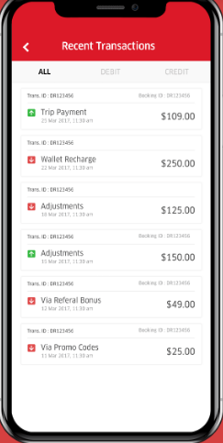
Referrals
Increase your customised taxi app user base by providing referral codes that can be shared with people.
Recent Transactions
View all prior bookings & payments done on the Taxi booking app.

Slide 12
WEBSITE MODULES

Slide 13
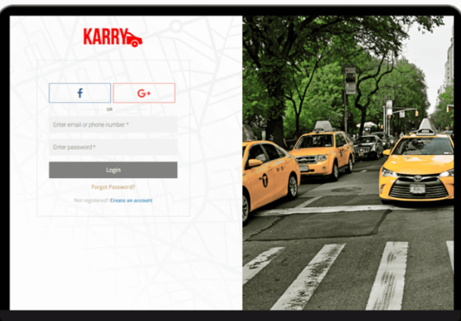

Register and Login
The online taxi booking script makes registration simpler via usage of social accounts.

Slide 14
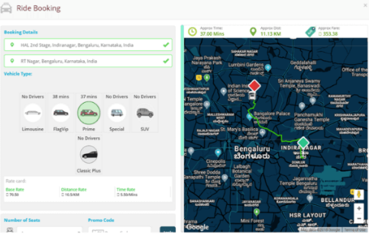
Book a ride
On-demand taxi booking or schedule a taxi ride. Add driver preferences, promo codes, payment methods etc while booking online.

Slide 15
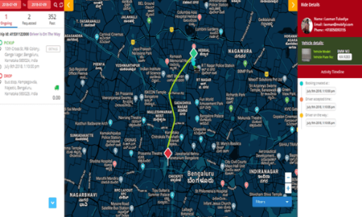
Live Tracking
Real-time ride tracking with booking status updates.

Slide 16
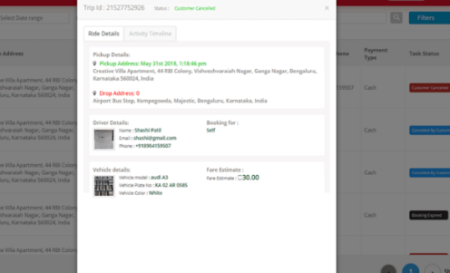
Past Trips
View details of all past trips booked on the taxi booking software.

Slide 17
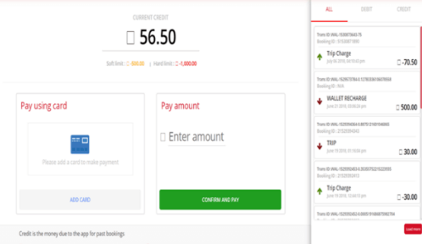
Payment and Wallet Recharge
View all past payments done & recharge your wallet directly on the website itself.

Slide 18

Thank You
25

